Slide 1
Christmas in July
July 2021

Slide 2
Free Standing Embroidered Lace
Christmas Ornaments

Slide 3
Materials List
Embroidery machine
Embroidery design pattern
Embroidery needles
Embroidery thread
Embroidery design
Embroidery hoop to fit the design
Curved scissors
Wash Away/Soluble stabilizer

Slide 4
Set up your Embroidery Machine
Follow the instructions in your sewing machine manual
Put in a new embroidery needle
Ensure you have dropped your feed dogs
Put your single stitch throat plate on your machine
Put your embroidery foot on your machine
Use the correct bobbin case (if applicable)
Connect your embroidery module (make sure you are working on a flat stable surface)
Wind bobbins in your desired colors.
Just a hint if you use white in the bobbin you can always color the back with a matching Sharpie

Slide 5
Hoop your stabilizer
You will use a water soluble or wash away stabilizer.
For stand alone lace I use two layers of stabilizer
Select the hoop size that will support your chosen designs
You can verify on your machine if you have the right sized hoop, or by the size of your hoop vs. the size of your design
Hoop your stabilizer

Slide 6
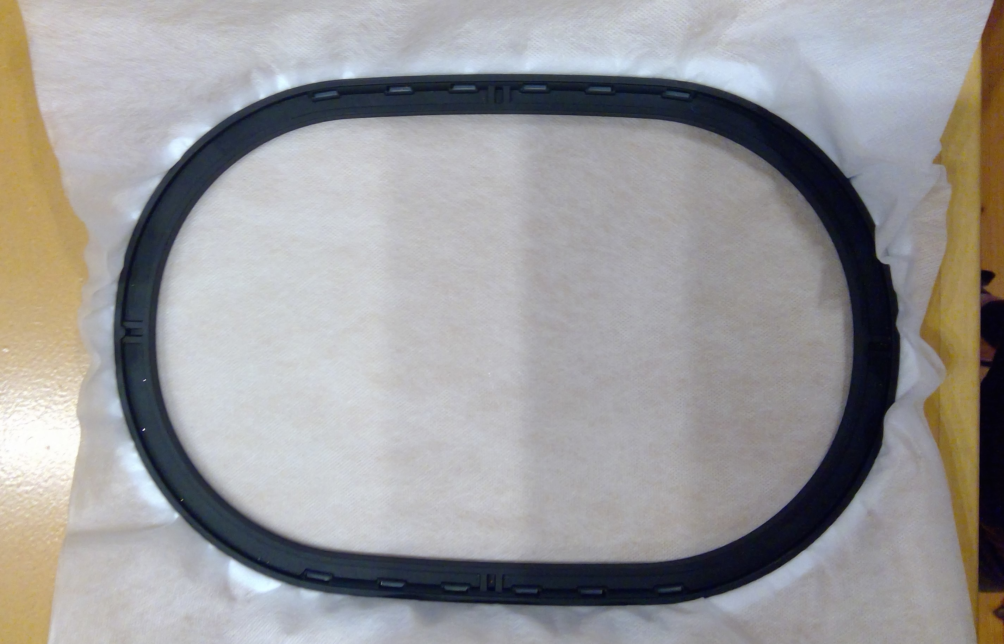
Hooped stabilizer

Slide 7
Open your design on your machine
Select the correct hoop on your machine
Put your embroidery hoop on your machine
Confirm your chosen design will fit in your hoop
Run your outline stitch (if applicable)
Start your embroidery design
Your machine will stop when your design has a color change
Change your thread and or bobbin if you desire to the next color
Your machine will automatically stop when the design is finished

Slide 8
Machine ready for a thread change

Slide 9
Next Steps
Remove your design from your hoop
Trim the stabilizer close to the design
Rinse your design under warm water until all the stabilizer is dissolved
Pat dry flat with a towel and lay your design flat to dry

Slide 10
Design ready for removal of the stabilizer

Slide 11
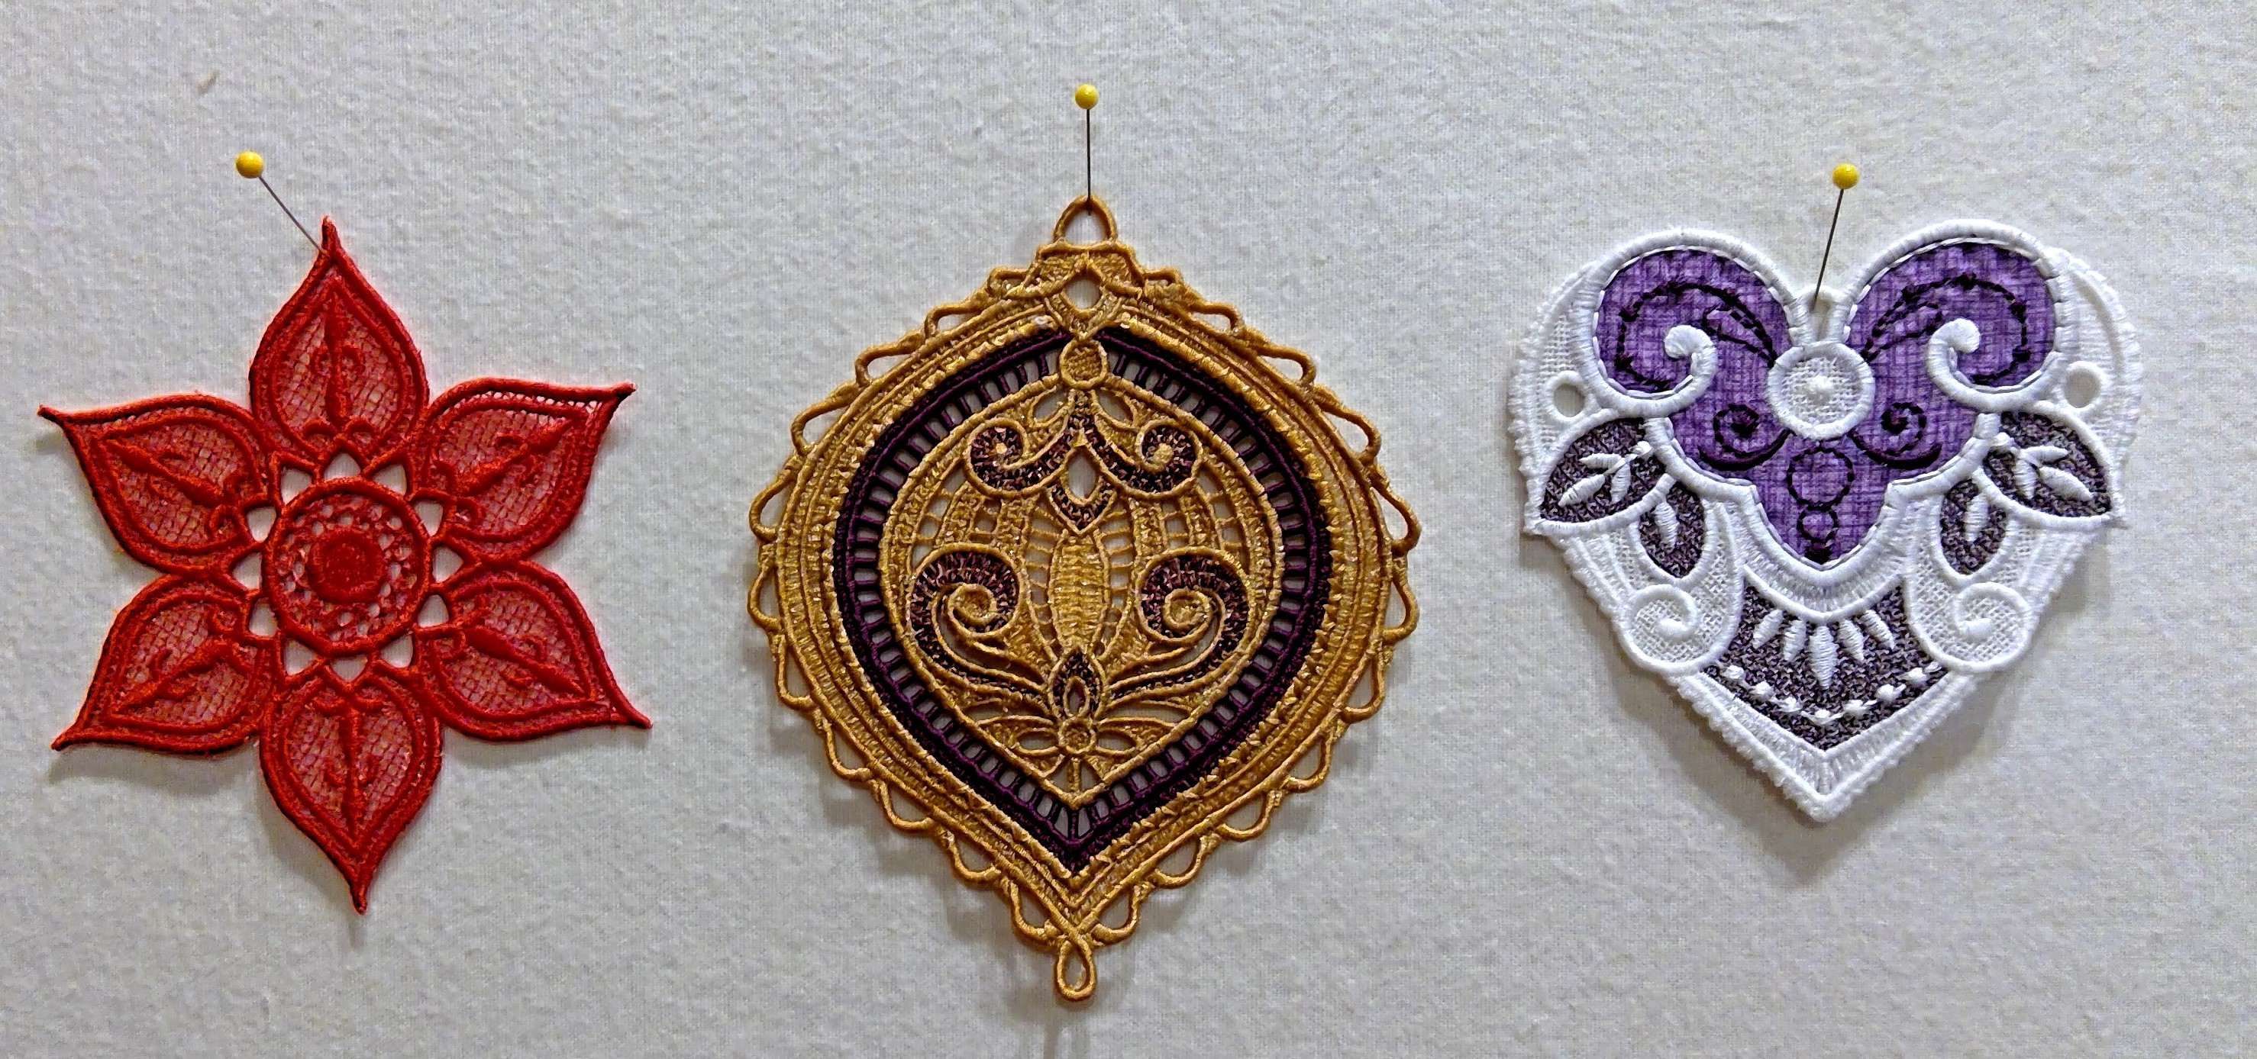
Completed examples

Slide 12
Resources
Your machine manual, your dealer and your machine manufacture's website
Google Free Standing Embroidered Lace and look at images to see what else you can do with this technique
There is a lot of information online from stabilizers to designs
Just a few examples of online information
https://www.urbanthreads.com/tutorials.aspx?t=Stitching+Freestanding+Lace
https://weallsew.com/embroidery-basics-how-to-make-free-standing-lace/
https://oesd.com/

Slide 13
Questions ???

Slide 14
HST Stocking
Paper Piecing
Pinwheels & Chevrons
Quilting
Stocking Assembly
Adding a hangar & cuff

Slide 15
Make some Half Square Triangles
Choose either size of HST
Place fabrics RIGHT sides together with the paper on top
Pin paper & fabrics together

Slide 16
Prepare to Stitch
This is simple paper piecing
Shorten your stitch length – A LOT
Shorter stitches make tearing the paper away easier

Slide 17
Stitch
Stitch along the light grey lines
It is ok if you go “out of bound”
Don’t forget that square of stitching in the center of the top 4 “squares”
DO NOT stitch on the solid black lines

Slide 18
Trimming
The black solid lines are your cut lines
Trim around the entire page

Slide 19
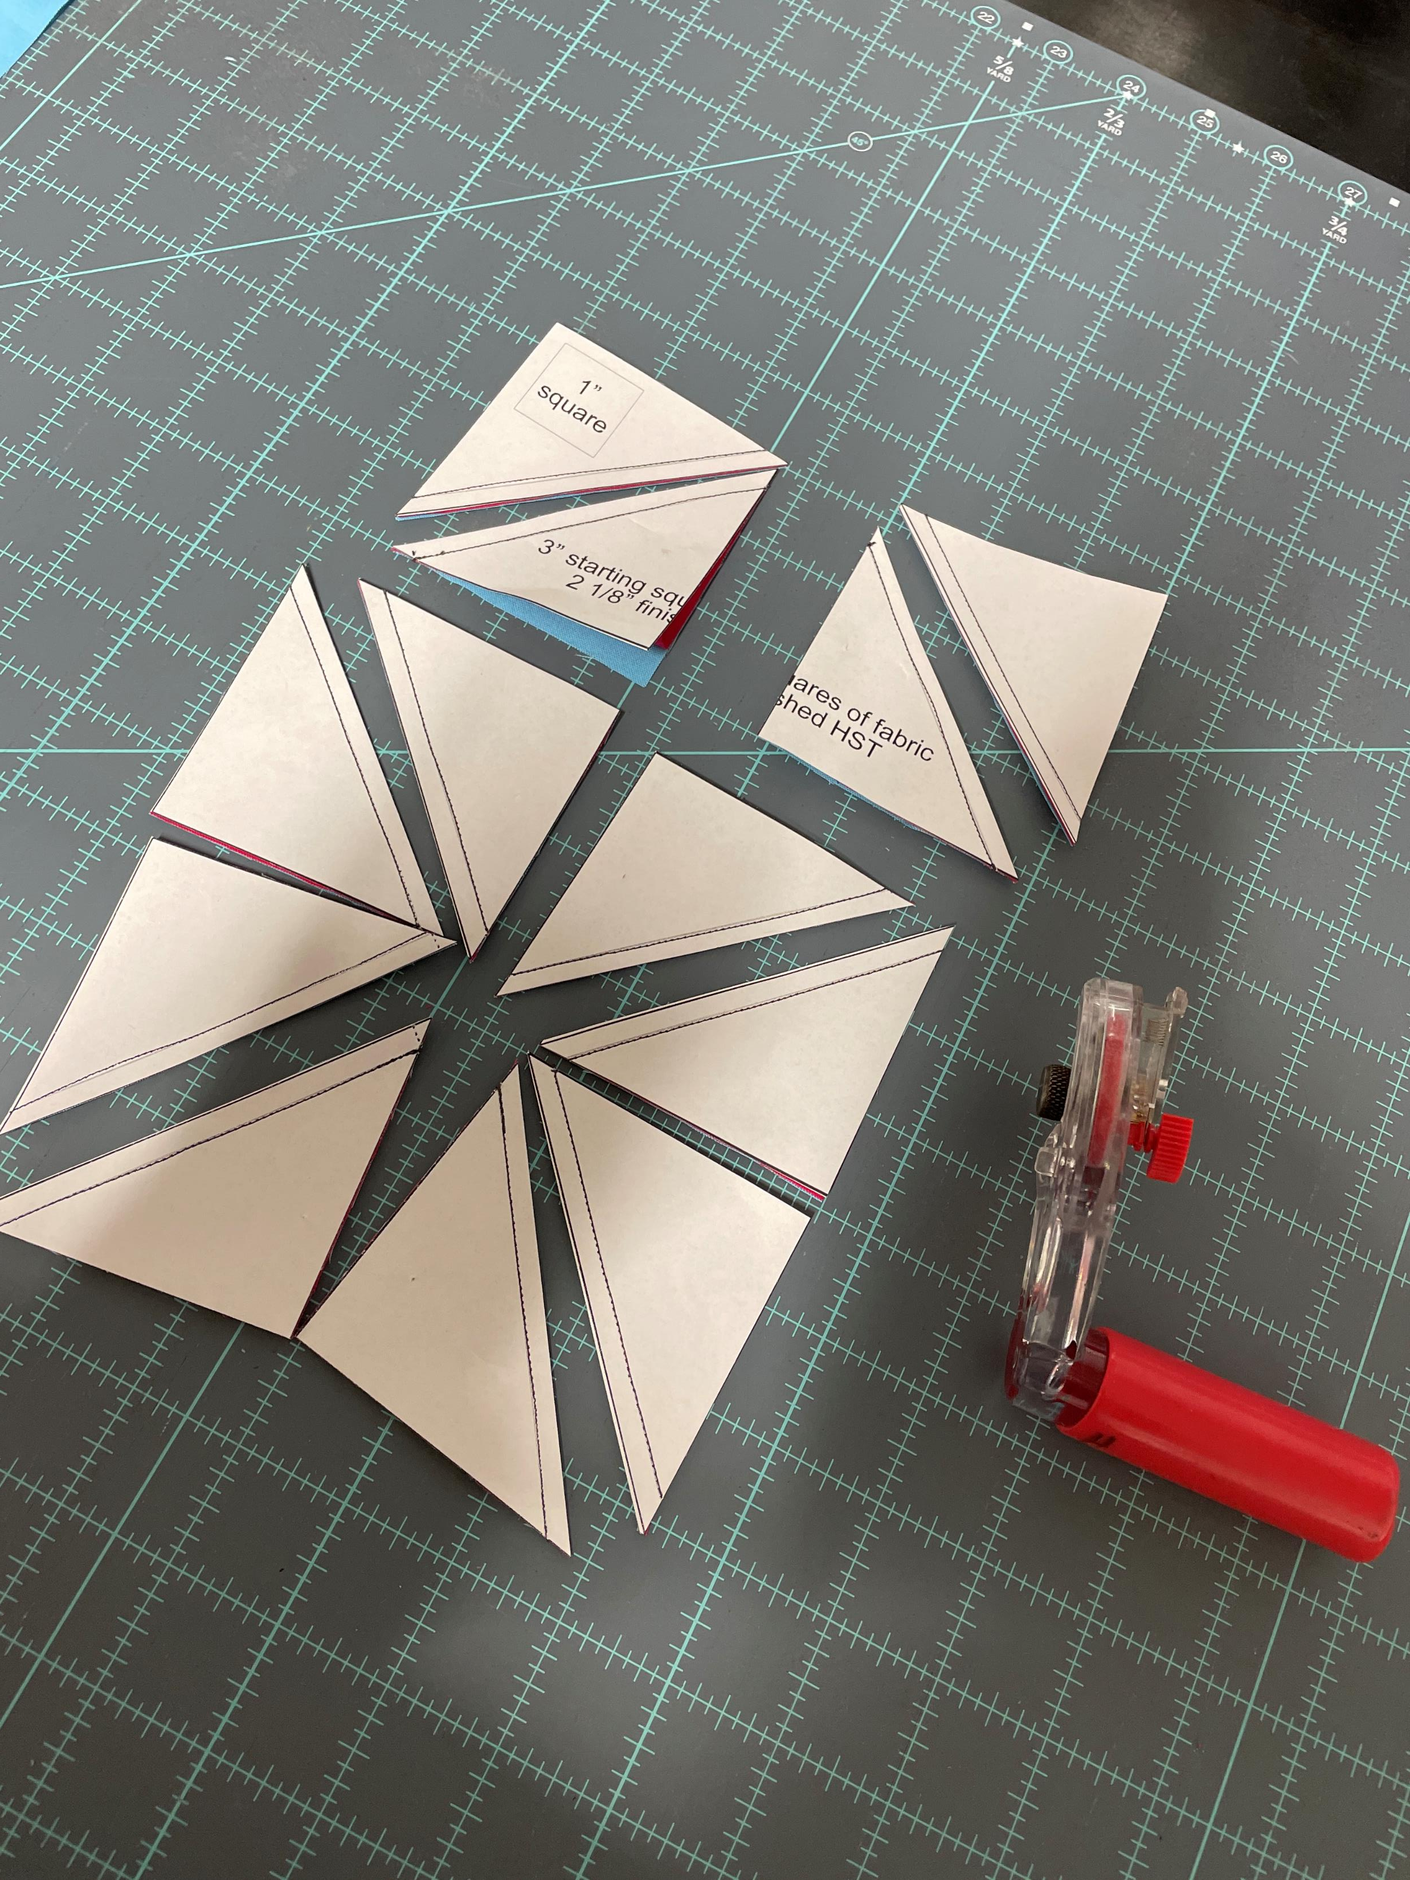
Keep Trimming

Slide 20
Tear & Press
Tear off/remove papers
Press open
For Pinwheels press all to the dark
For Chevron press open or press half to dark, half to light

Slide 21
Chevron
To create a chevron design this is the layout
Key points – you will struggle if you press all seams the same way

Slide 22
Pinwheels
To create pinwheels this is the layout
Pressing all seams the same direction works great with this layout

Slide 23
Stocking Assembly
Print template, tape & cut it out
Use template to determine how large to piece your HST chevron or pinwheel design
Stack your “top”, batting & lining fabric & quilt as desired
Choose a single or quilted layer for the stocking back – stack & quilt as desired if appropriate
Mark & cut the pattern on front & back (make sure your pattern is right side up/down so your toes match!)

Slide 24
Front & Back Assembly
Layer stocking front & back with RIGHT sides together and pin
If you are attaching a hangar sew it hanging down “into” the stocking attached to the back corner

Slide 25
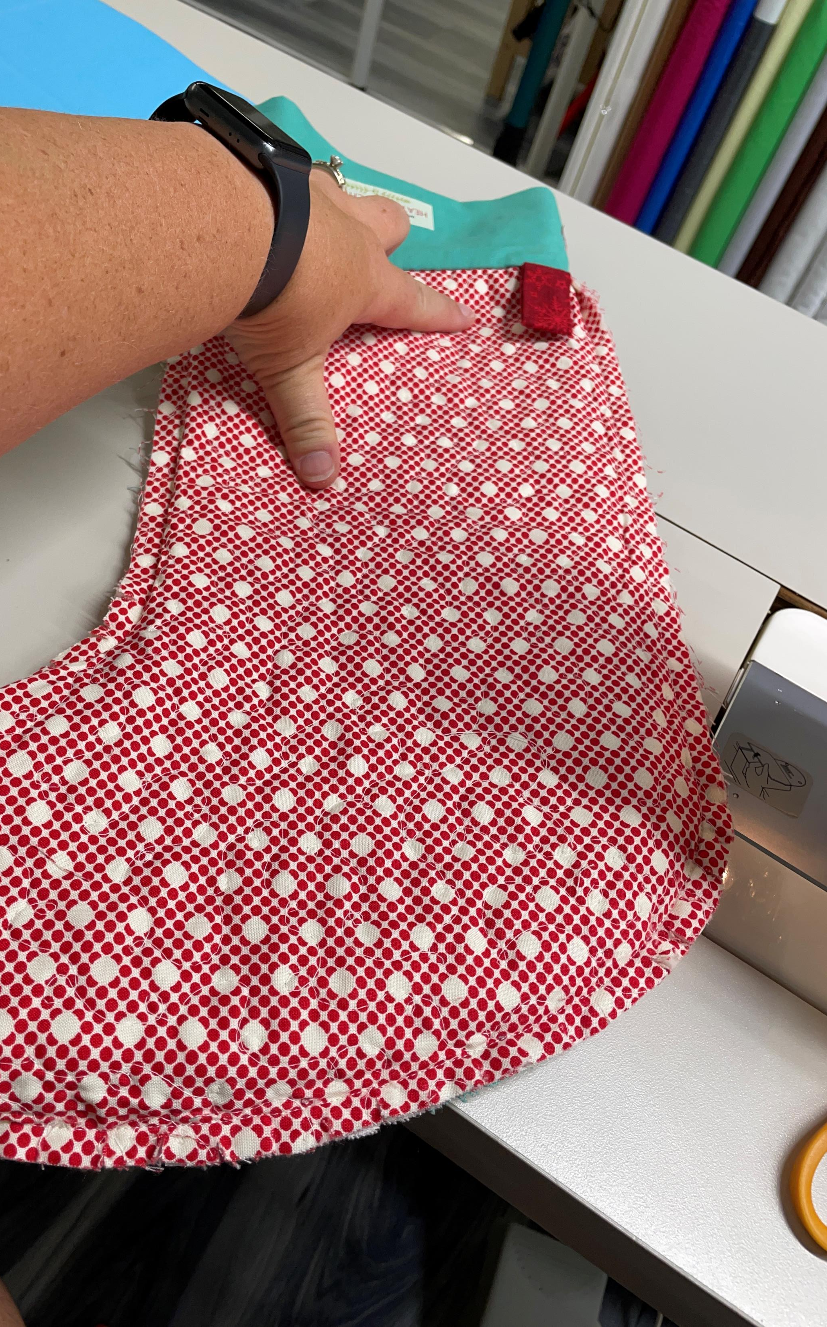
Hangar details
Jumping ahead a bit to a finished stocking but you can see the hangar placement & how it lays down “into” the stocking on the left is how you sew it on.

Slide 26
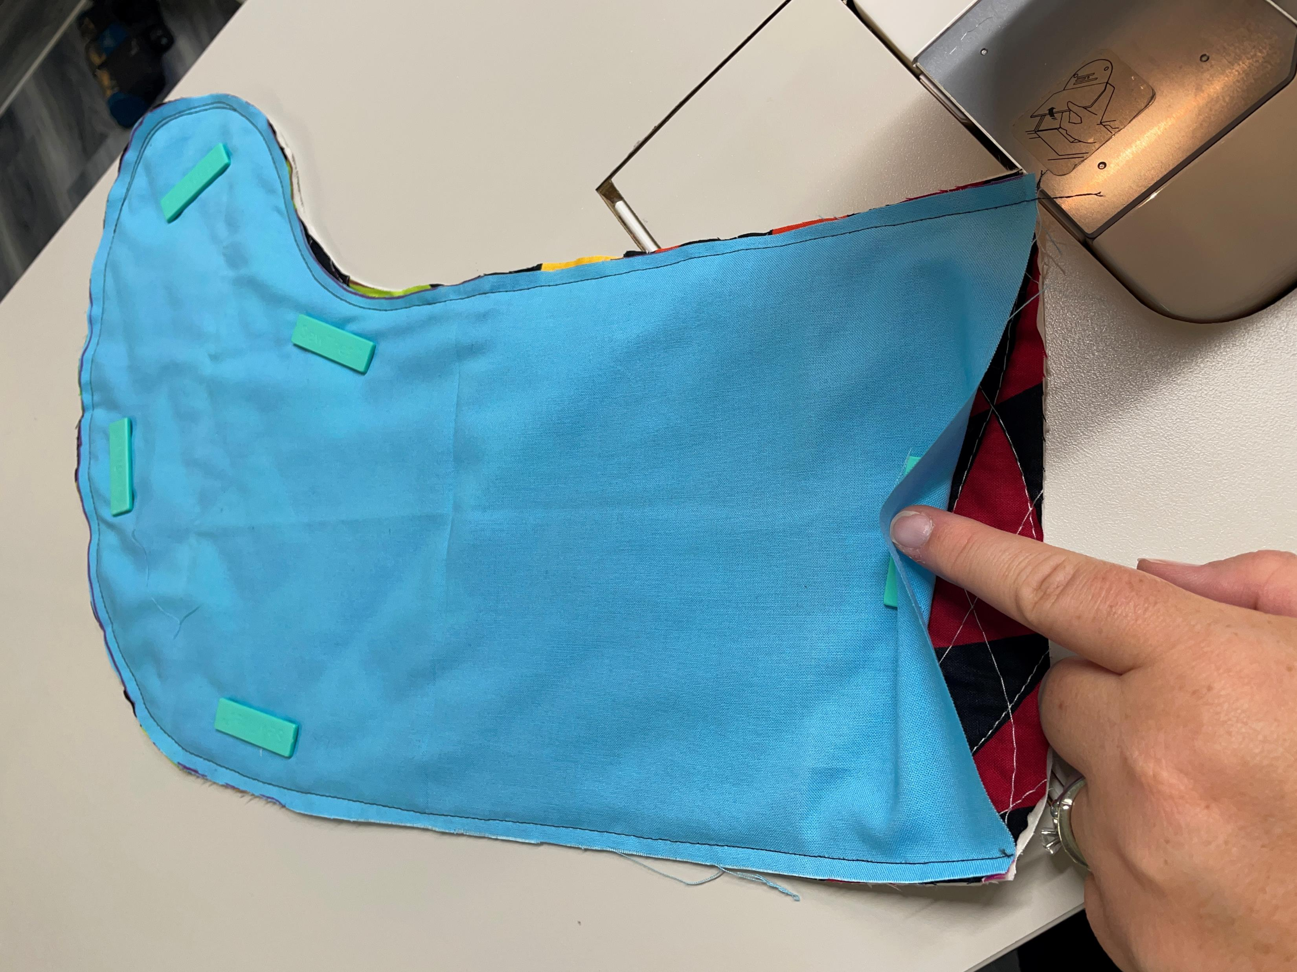
Sew Stocking Front & Back
Stitch down the sides & bottom leaving the top open
Using a scissors trim the curves – do NOT cut through your stitching line

Slide 27
Make the cuff
Cut a 6.5x15.5” rectangle of fabric
Fold rectangle in half on the long side with right sides together
Stitch short edge

Slide 28
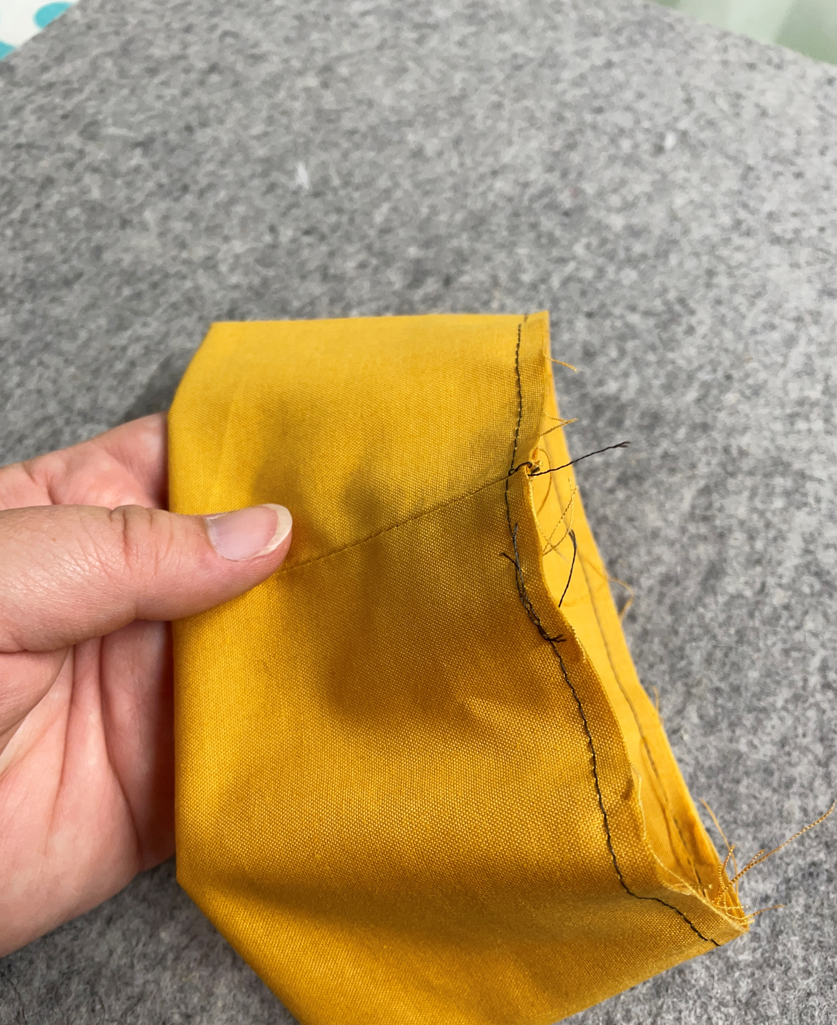
Cuff next steps
Press seam open
Flip the cuff right side out
Fold the cuff in half with the seam on the inside
Stitch the cuff closed

Slide 29
Cuff next steps
Tuck the cuff into the stocking with the raw edges lined up
Line the seam up with the center of the back of the stocking
Pin & stitch the cuff to the stocking

Slide 30
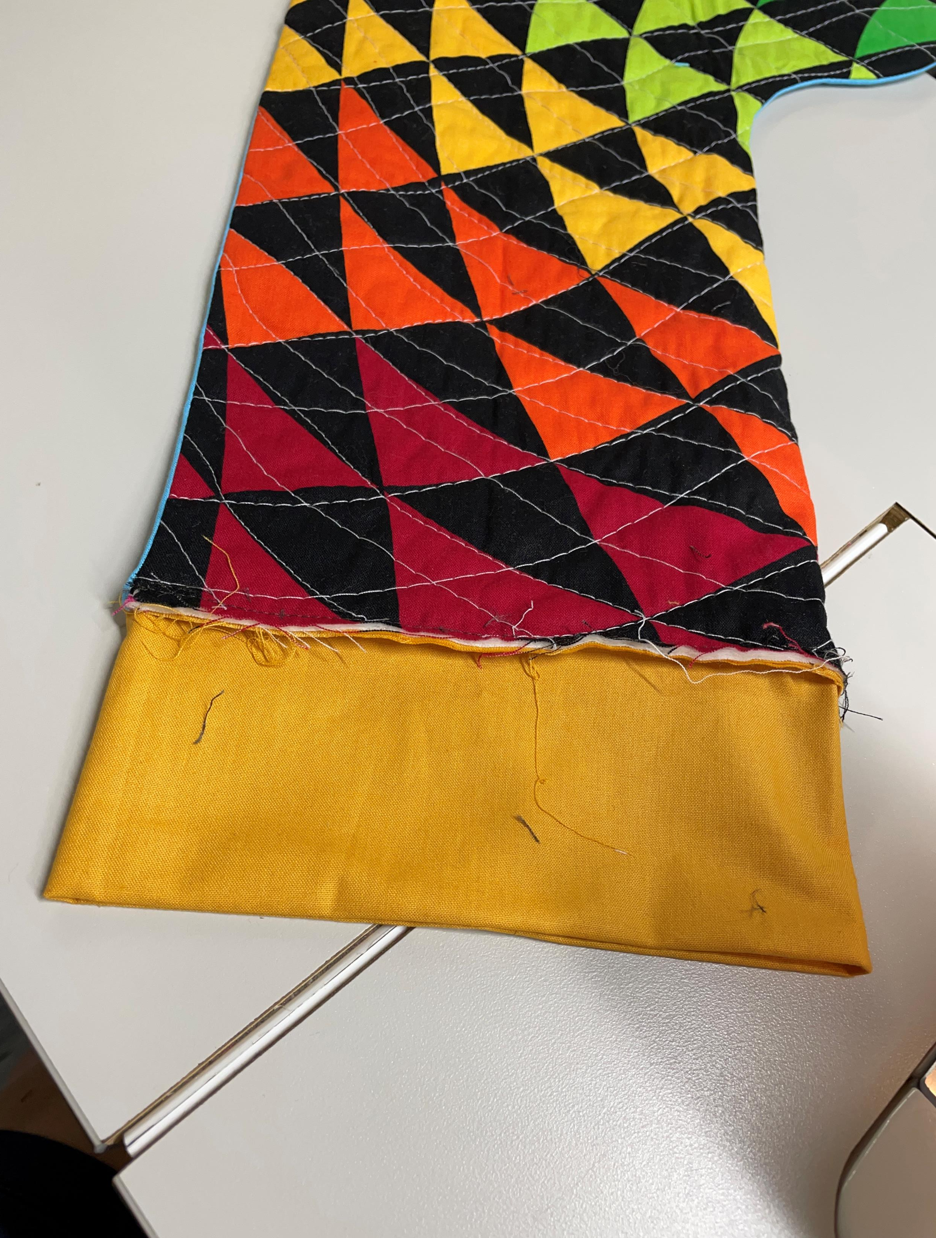
Finish
Flip stocking right side out
Push the seams out focusing especially on the curves
Use a chop stick, purple thang, or other tool
Fold the cuff down over the stocking
Carefully press all seams

Slide 31
Questions ???

